Slide 1








TB Hackday December 10, 2024
Andrew Fiore-Gartland, Ph.D.
Fred Hutchinson Cancer Center
Shuyi Ma, Ph.D.
Seattle Children’s Research Institute
Kim Dill-McFarland, Ph.D.
University of Washington
Thanks to Jill Anderson, Sadie Reitz and Jordan McCrary for help organizing!

Slide 2
Land acknowledgement
SEATRAC acknowledges the Coast Salish peoples of this land, the land which touches the shared waters of all tribes and bands within the Duwamish, Puyallup, Suquamish, Tulalip and Muckleshoot nations.

Slide 3
TB Hack Day Objectives
Specifically learn and teach:
TB pathogenesis
BCG vaccination
granuloma biology
Blood and tissue immunology
NHP Mtb. challenge model
transcriptomics bioinformatics
single-cell data manipulation
differential expression
clustering and machine learning
Learn
Hypothesize
Visualize
Build community
Teach

Slide 4
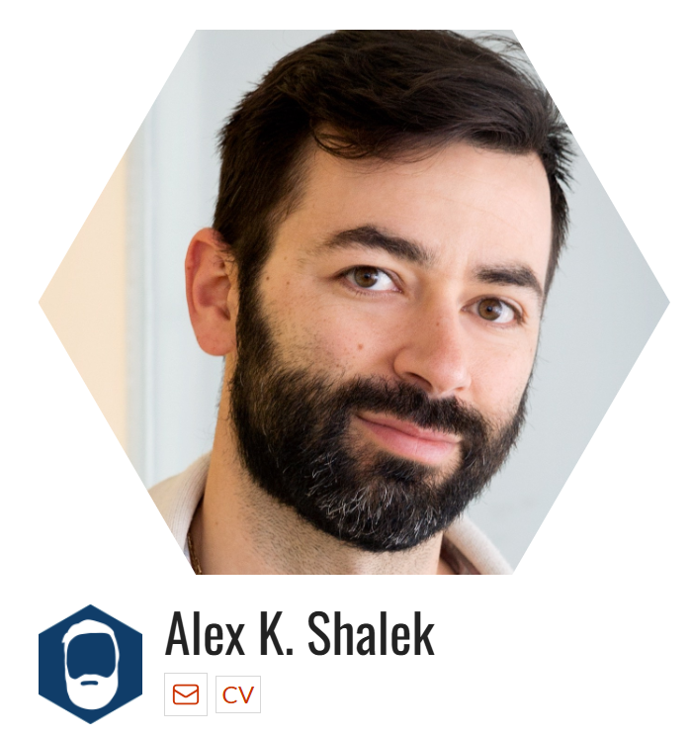

Guest speakers
Alex Shalek, Ph.D., Professor MIT
Josh Bromley, graduate student MIT
Notes:
Alex Shalek, Professor MIT
Professor in the Institute for Medical Engineering and Science and the Department of Chemistry Director of Health Innovation Hub Director, Institute for Medical Engineering and Science, MIT
Immunologist, engineer and terrific translational collaborator, will talk about his work with Tricia Darrah, Bob Seder and colleagues looking at immunity induce by intravenous BCG in NHP, and work with JoAnn Flynn and Sarah Fortune looking at immunity from a primary Mtb infection.
Josh Bromley is a graduate student in the Microbiology program at MIT, lead author on their recent study of Mtb immunity in NHP

Slide 5
Agenda for today
Emory (EST) | Seattle (PST) | Activity
9:00 AM |  | Alex Shalek and Johsua Bromley presenting on correlates of protection for IV BCG and Mtb immunity in NHP (live)
9:45 |  | Opening remarks (Shuyi Ma, Andrew Fiore-Gartland)
10:00 |  | Small group session: devise questions, hypotheses and analysis plans
10:30 |  | Open hack time at Emory
 | 8:30 AM | Gather with coffee and light breakfast
 | 9:00 | Opening remarks (Shuyi Ma, Andrew Fiore-Gartland)
 | 9:15 | Alex Shalek and Johsua Bromley presenting on correlates of protection for IV BCG and Mtb immunity in NHP (live)
 | 10:00 | Small group session: devise questions, hypotheses and analysis plans
 | 10:30 | Open hack time in Seattle
3:00 PM | 12:00 PM | JOINT Small group readouts from Emory: Each group shares preliminary figures, analysis plans, code chunks
 | 3:00 | Small group readouts from Seattle
Feel free to come and go, change seats, move rooms, go for a walk, etc.
Small groups are meant to facilitate conversation and collaboration; use them as much or as little as you want
Make sure to plan for a way to get your work off the Rstudio servers at days end
Be open, curious, inclusive, respectful!
Let’s make this the best that science can be: Free food + free flow of thoughts and ideas
Code of conduct: We’re committed to hosting TB Hackday as an inclusive and harassment-free learning experience for everyone.
Real-time feedback welcome!

Slide 6
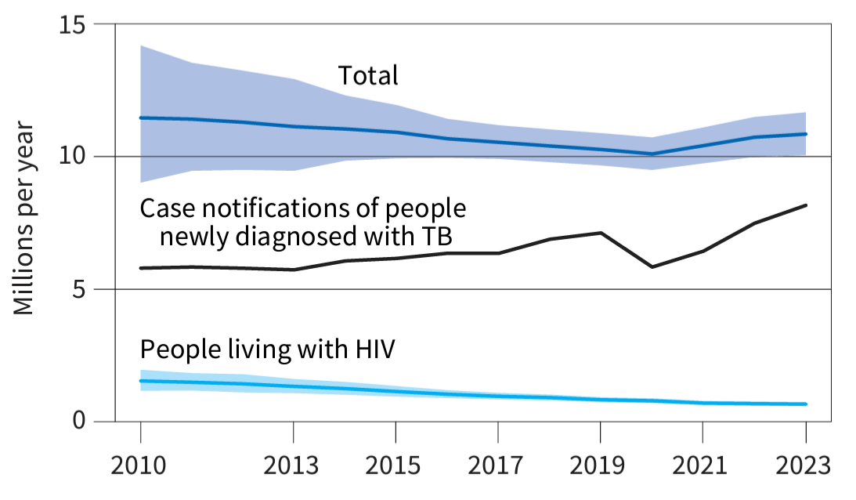
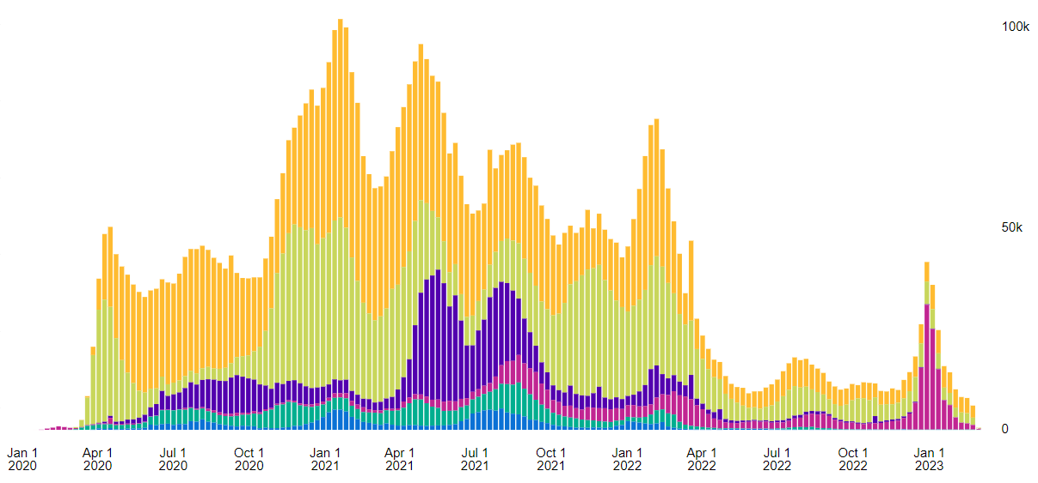
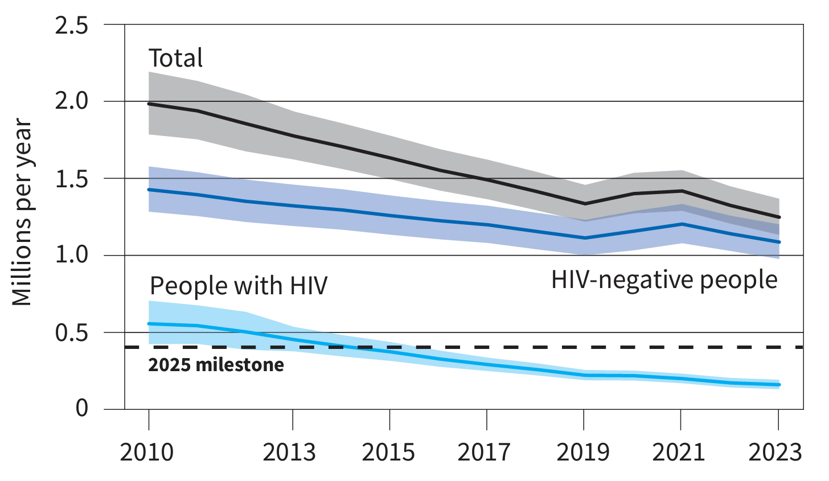

Global trends in the estimated number of incident TB cases (in millions)
WHO Global Tuberculosis Report 2023
TB notifications are rising since the COVID pandemic interrupted health services
Under-diagnosed and under-treated TB led to an increase in TB deaths during pandemic
Comparatively COVID-19 deaths were 3.5 M and 1.2 M in 2021 and 2022
Global trends in the estimated number of deaths caused by TB and HIV (in millions)
Global COVID-19 deaths (weekly, WHO)
1.25 M TB deaths in 2023
Avg. 29K weekly TB deaths
WHO Global Tuberculosis Report 2024
Notes:
Deaths have begun to decline again, but not below pre-pandemic levels

Slide 7
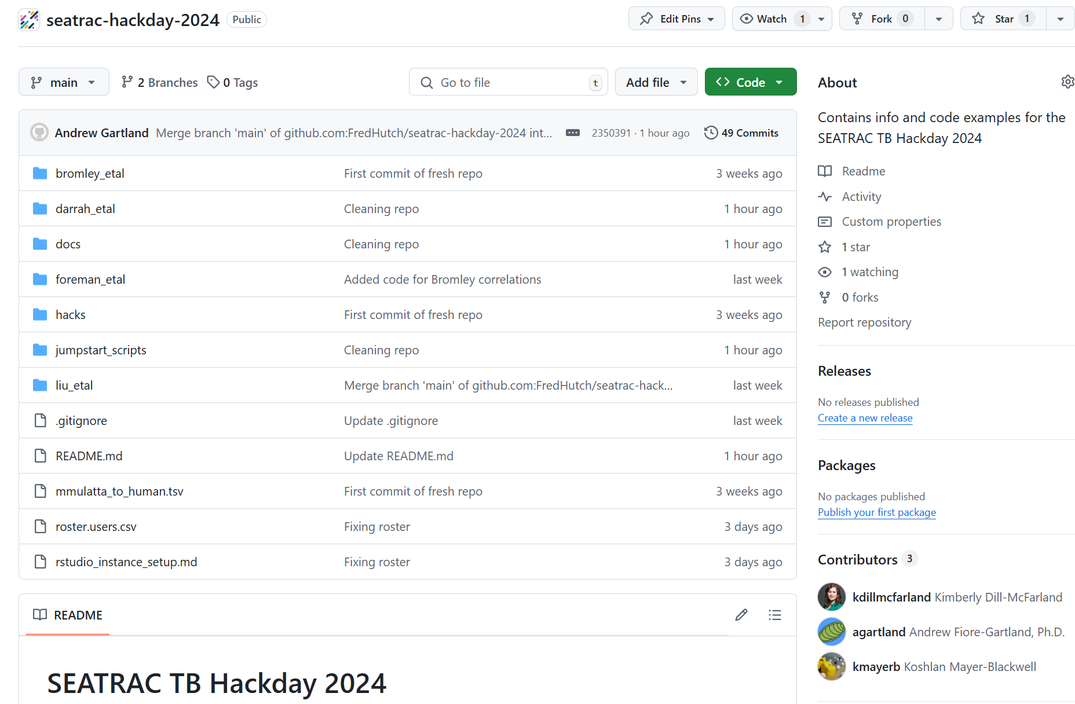
Github repo contains manuscripts, meta-data and bulk RNA seq data
On servers the repo is copied to:
/home/seatrac-hackday-2024
You may want to clone the repo into your home directory where you have write-access:
cd /home/[USERNAME]
git clone https://github.com/FredHutch/seatrac-hackday-2024.git
Or if you’re a git “pro”, fork the repo first so you can push your findings from the servers.
https://github.com/FredHutch/seatrac-hackday-2024

Slide 8
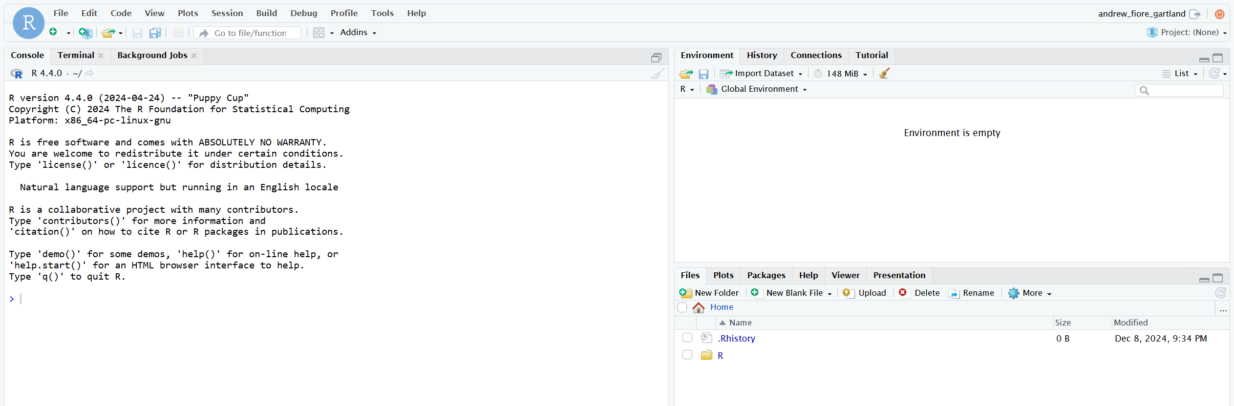


On servers the jumpstart scripts are at:
/home/seatrac-hackday-2024/jumpstart_scripts
You need to make a copy of the jumpstart scripts to your home folder to save edits or render the Quarto markdown (QMD)
You can use the Terminal to clone your own copy of the repo or make a copy
All the data is located at:
/home/processed_data
Change your home folder to:
/home/[USERNAME]

Slide 9


Opportunities to get involved in TB research
Join SEATRAC or your local NIH TB Research Accelerator (TRAC)
Join for access to Clinical, Immunology and Data Science Core services (e.g., BSL3 trainings, sample repository, data science consultations, seminar announcements)
SEATRAC seed funding ($50K/yr for 2 yrs): “New to TB” and “New Investigator” awards
Regular seminar series (monthly at UW SLU)
https://seatrac.uw.edu/

Slide 10
Thank you for participating!
Your feedback is welcome for next time

Slide 11
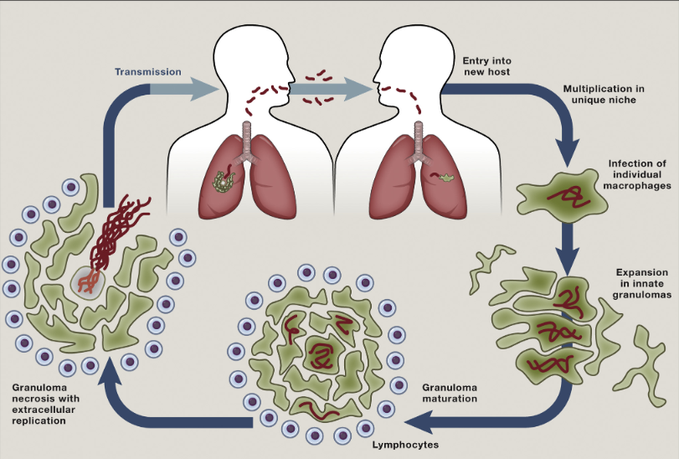
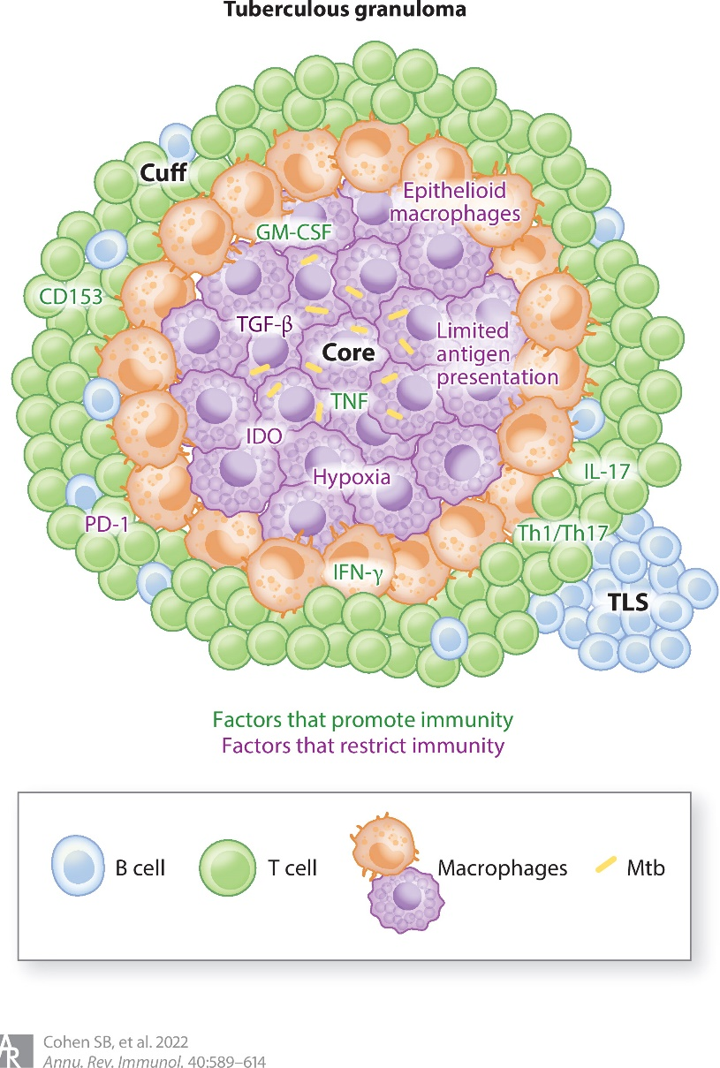

Basics of tuberculosis pathogenesis
Mycobacterium tuberculosis (Mtb) is a single-celled respiratory pathogen
Transmitted through breathing and coughing
Intracellular pathogen primarily infects macrophages in the lung
Granulomas: organization of immune cells, with infected macrophages at the core, surrounded by a cuff of lymphocytes
CD4+ and CD8+ T cells are thought to play a prominent role in recognizing and killing Mtb. infected cells
Symptomatic disease develops only in a small subset of infected individuals, and may develop years after exposure
Antibiotics can be used to treat TB disease, though the standard therapies can last 6 months with daily pills
Cambier et al., Cell 2014
Cohen, Gern and Urdahl, Ann Rev, 2022

Slide 12
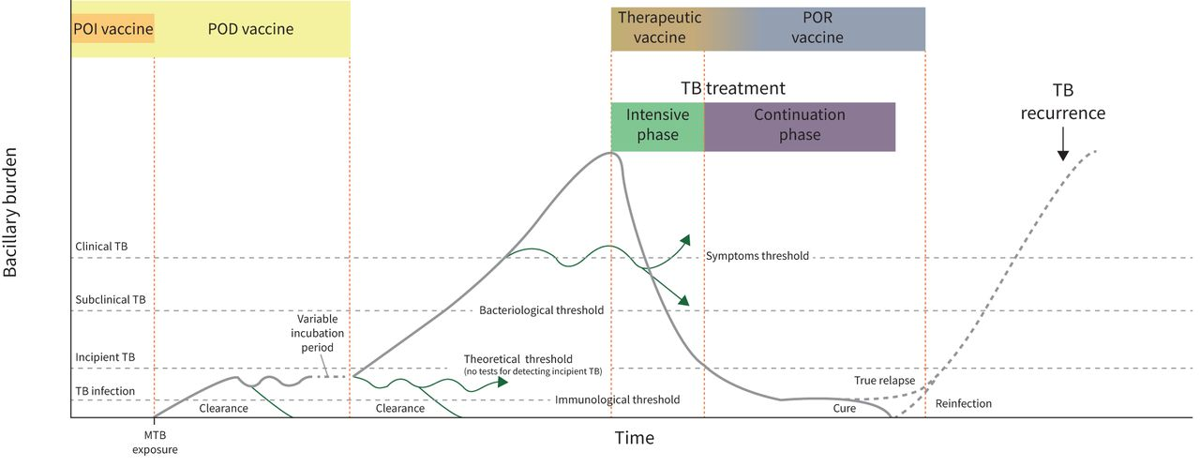
Spectrum of disease + opportunities for intervention
Transmission?
Age
(Garcia-Basteiro A, et al., Eur Resp Rev, 2022)
Notes:
Clinical endpoint: microbiologically-confirmed TB disease
POI
POD
POR
Interrupting transmission also a consideration
Age: POI targets infants and adolescents, POD for adults and PLWHIV

Slide 13
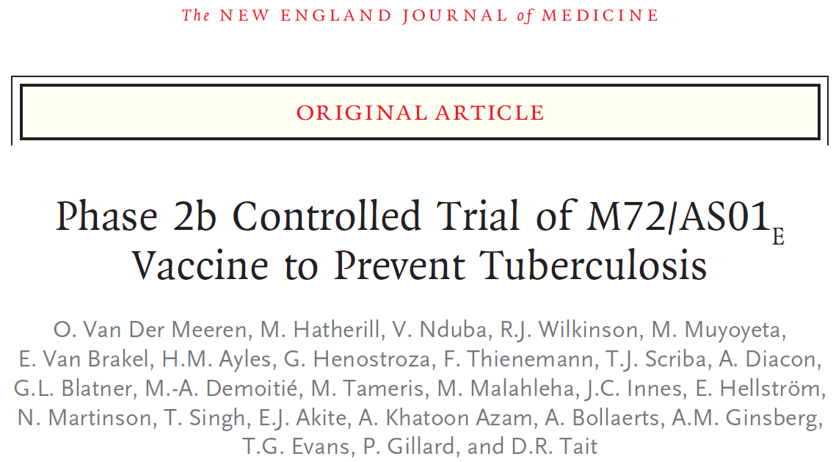
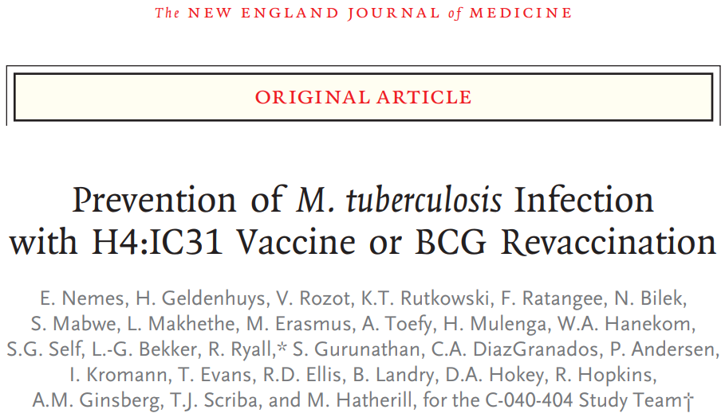
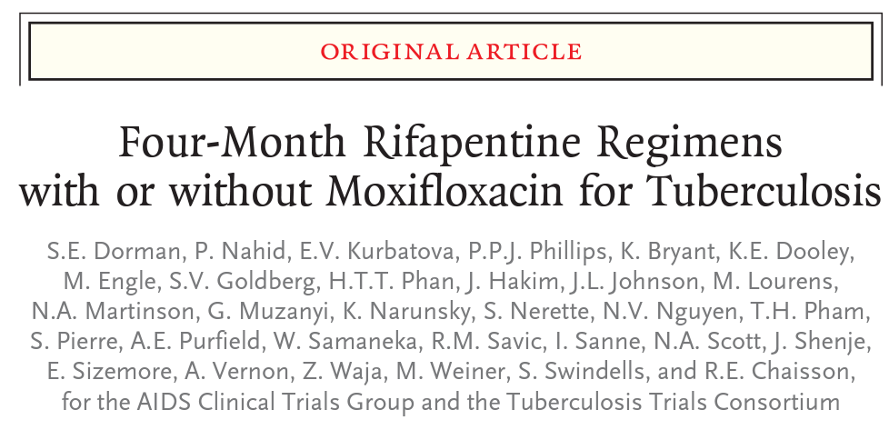
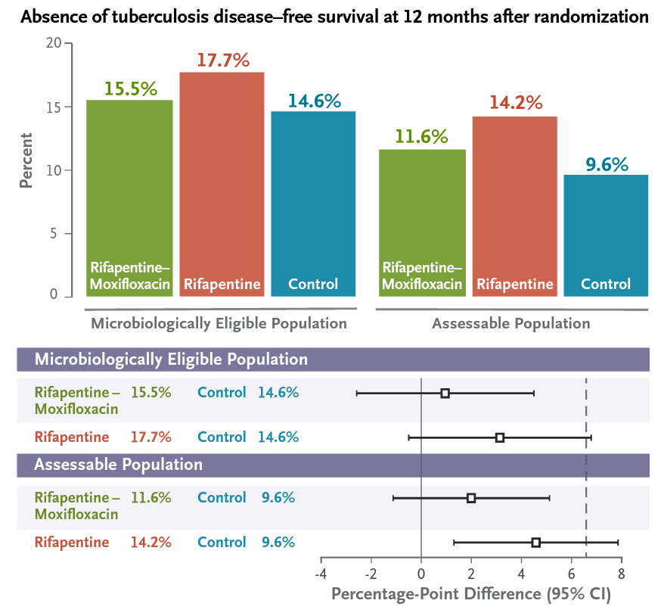
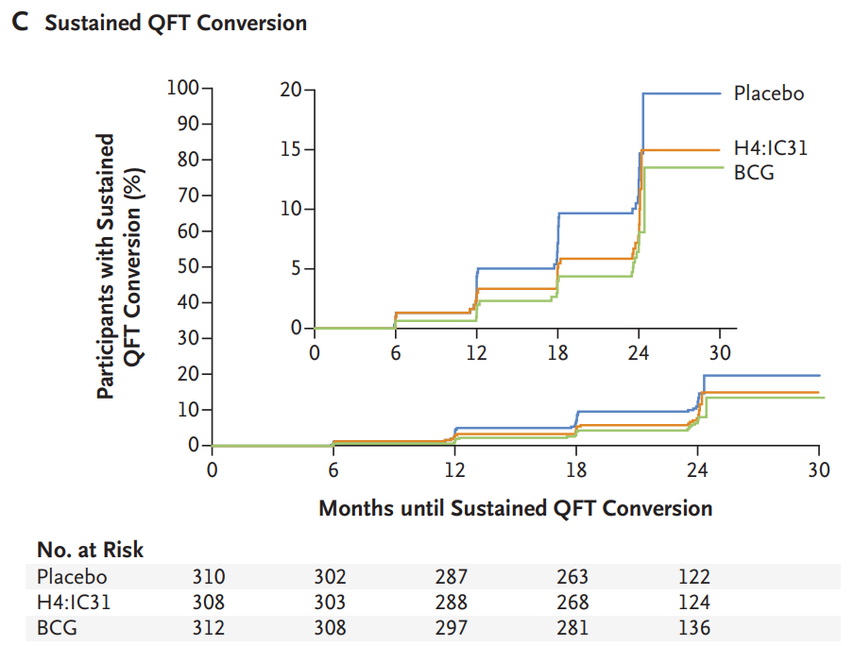
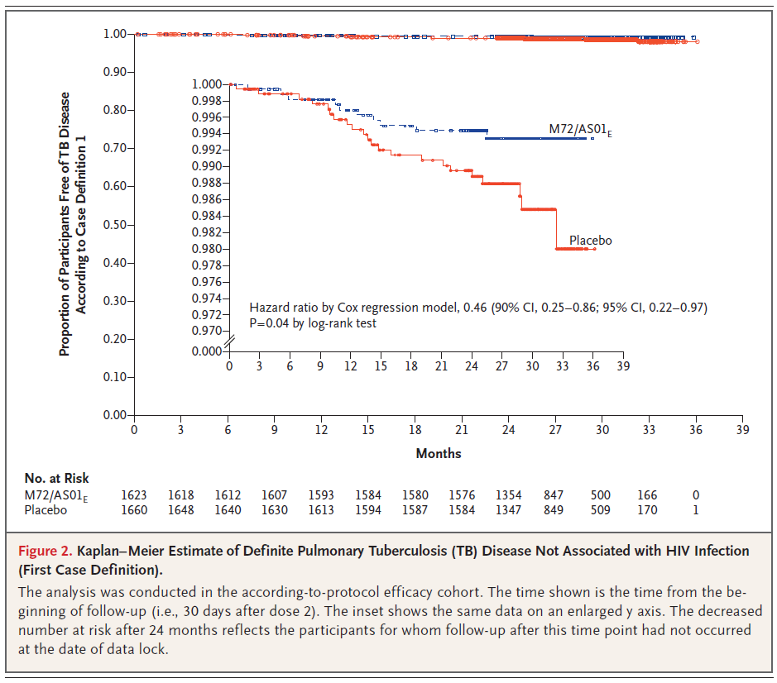
Reasons for optimism in TB prevention and treatment
2019
2018
2014
Four-month regimen is non-inferior to standard TB therapy
M72/AS01E vaccine had 50% efficacy against TB in Ph 2b
BCG revaccination had 45% efficacy against Mtb. infection*
Non-inferior 2-month regimen (CROI 2023)
Notes:
Researchers at the Conference on Retroviruses and Opportunistic Infections in Seattle presented findings on Feb. 20 from the TRUNCATE-TB trial showing that a shorter, eight-week regimen for treating tuberculosis is just as efficacious and safe as the standard six-month regimen, which has been the standard of care for decades to treat TB. These findings may open the door to implementing shorter treatment regimens that improve adherence to treat and cure TB, which, up until the COVID-19 pandemic, had been the biggest infectious disease killer globally.

Slide 14
Study author | Key learnings | Datasets
Darrah et al., 2020 (route study) | IV BCG was superior in immunogenicity and protection compared to ID or aerosol BCG IV BCG induced substantially more CD4 and CD8 T cells in blood, spleen, BAL and lung LNs IV BCG protected 9/10 NHPs against a 6-mos Mtb. challenge | scRNA seq of BAL from 15 NHP at 13 and 25 wks post-BCG BAL was stimulated with PPD or unstimulated Mtb challenge at week 26
Darrah et al., 2023 (dose study) | Dose-ranging study of IV BCG showed range of protection Mtb-specific CD4 Th1/Th17 and NK cells in the airway correlated with protection Blood markers also correlated, but less strong | Raw immunogenicity data not included Subject challenge outcome data available in Supp Materials
Liu et al., 2023 | Blood transcriptional analysis of Darrah et al. IV BCG dose study Innate signatures at 2 days post-BCG correlated with lung T cell responses and predicted challenge outcome 6 mos later | WB bulk RNA seq at baseline, 2 days, 2 wks, 4 wks, 12 wks in 34 NHP WB bulk RNA seq from Darrah et al. “route study” also
Foreman et al., 2023 | Compared T cells from blood, BAL and granulomas 6-7 wks post Mtb challenge TNFRSF8/CD30 was among the top genes upregulated in granuloma CD4/CD8 T cells CD30-/- mice succumb early to Mtb infection Previously, CD30-ligand (CD153) also implicated in protection | Bulk RNA seq from sorted T cell populations (83 samples) CD4/CD8 T cells from BAL and granulomas (23 granulomas, 4 NHP) Paired CD4/CD8 memory T cells from blood Granuloma burden CFU
Bromley et al., 2024 | Studied immunity provided by a primary Mtb. Infection in NHP by comparing to group without primary infection and group with ant-CD4 IgG to deplete CD4+ T cells prior to challenge (cynomolgus macaques) Presence of CD4+ T cells during reinfection resulted in a less inflammatory lung with reprogrammed CD8+ T cells, reduced neutrophilia, and blunted type 1 IFN among myeloid cells. | Primary Mtb + anti-CD4 IgG (n = 3 NHP) Primary Mtb + IgG isotype control (n = 3 NHP) No primary infection (n = 2 NHP) Pseudo-bulk RNA seq from granulomas Two cell clusterings: coarse or sub-clustered, defined by the authors of the manuscript CFUs of each granuloma

Slide 15
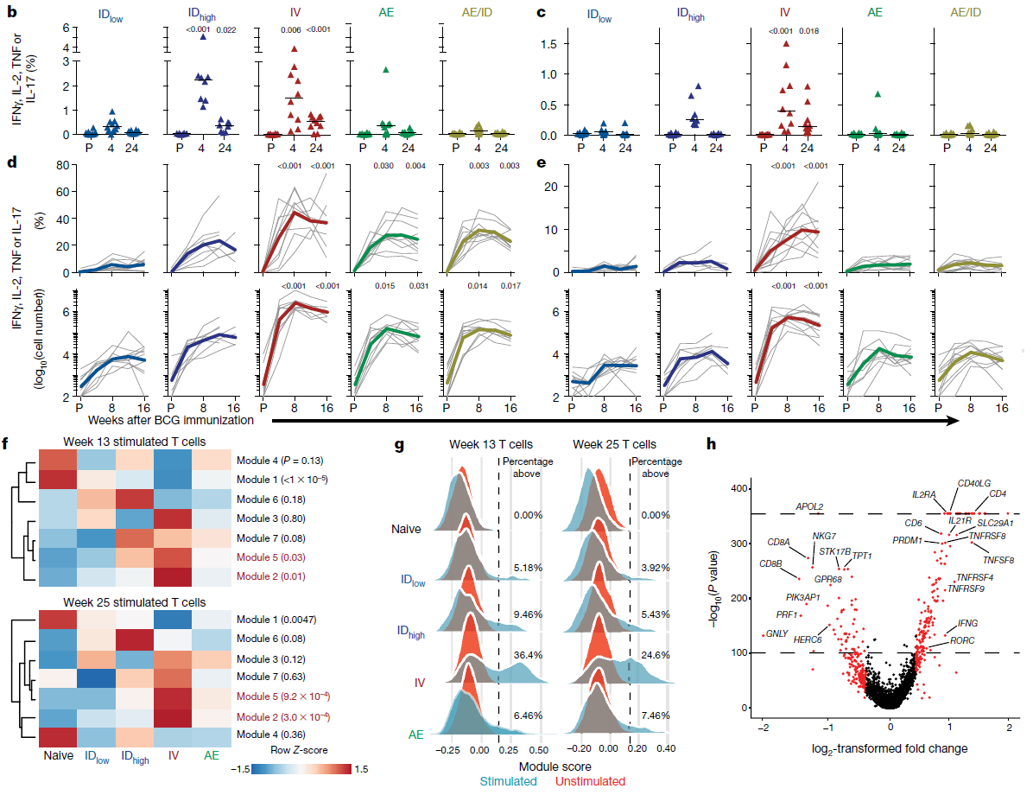
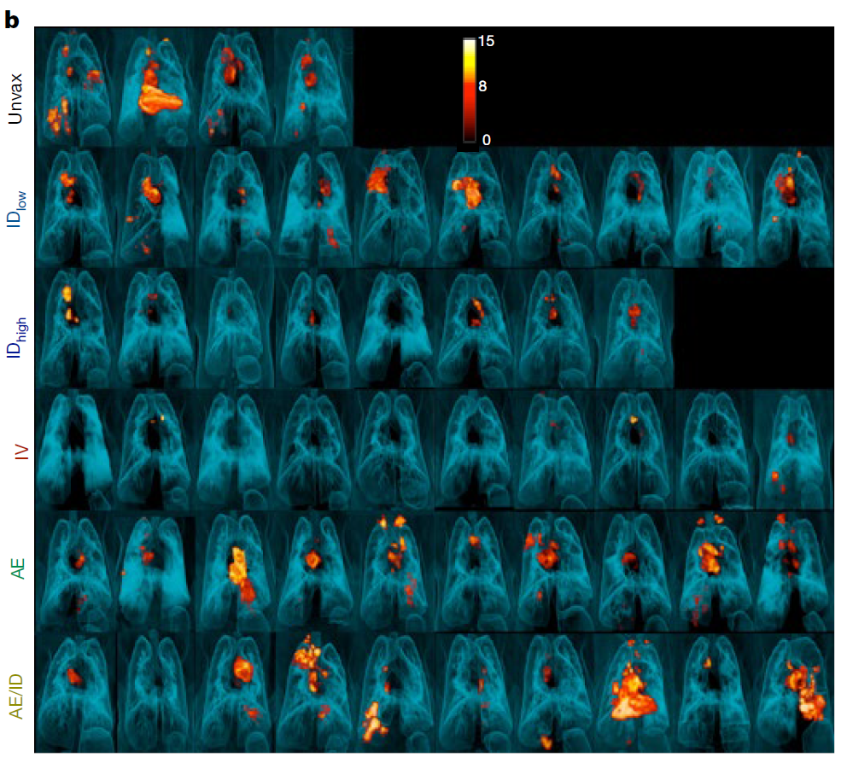
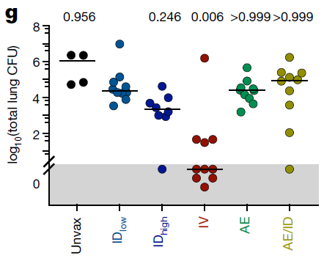
Darrah et al., BCG route study
Compared routes of BCG inoculation: intradermal (ID high and low), intravenous (IV) and aerosol (AE)
IV BCG was substantially more protective than other routes, with 6/10 animals having no detectable lung CFU
IV BCG elicited higher frequency of PPD-specific CD4+ and CD8+ T cells in the lung and blood
Route was the primary correlate of protection
CD4+ T cells
CD8+ T cells
PBMC
BAL
PET/CT showing active lesions at necropsy
Week 13
Week 25
Lung CFU
BAL scRNA SeqWell
T cells
Module 2 scores
by route
DEGs for Module 2 T cells
Darrah et al., Nature 2020

Slide 16
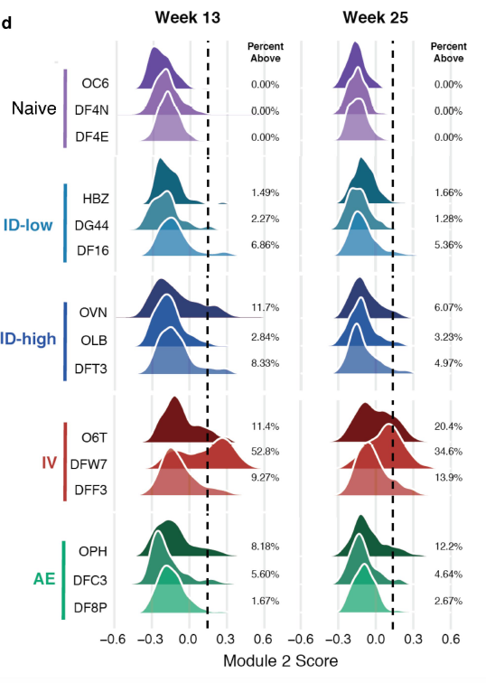
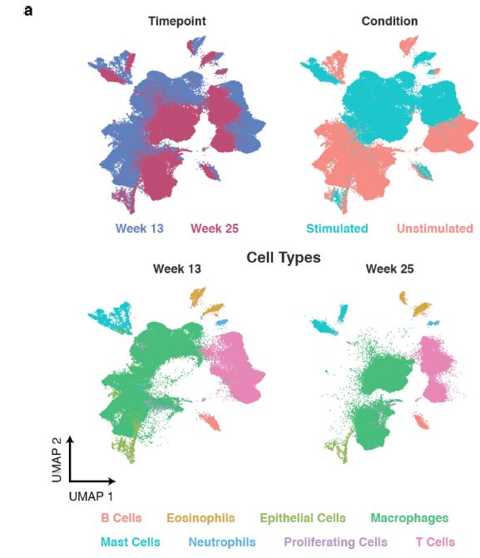
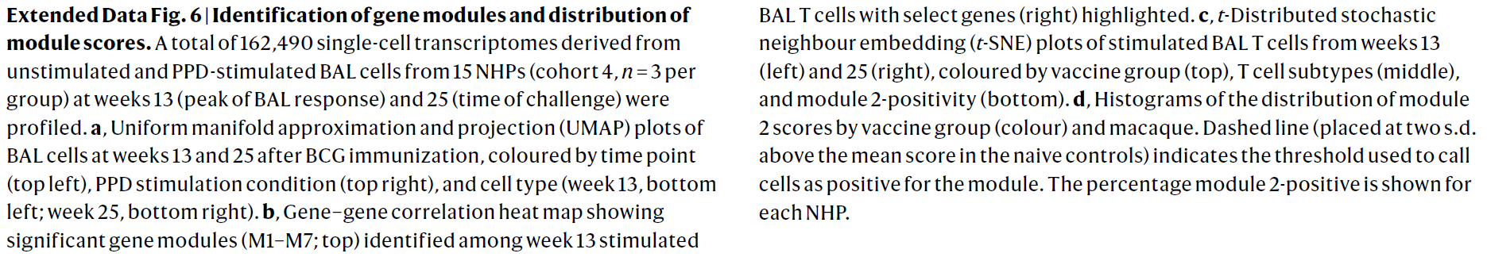
Darrah et al., BCG route study
Conducted scRNA seq using SeqWell on subset of animals (3 per route)
Samples from 13 wks (peak BAL response) and 25 wks (time of challenge)
Identified gene modules among T cells in PPD-stimulated and unstimulated conditions
Found that Module 2 (containing T memory genes) differentiated IV BCG from other routes
1 NHP
BAL scRNA seq w/ and w/o PPD stim
Darrah et al., Nature 2020
Notes:
Deaths have begun to decline again, but not below pre-pandemic levels

Slide 17
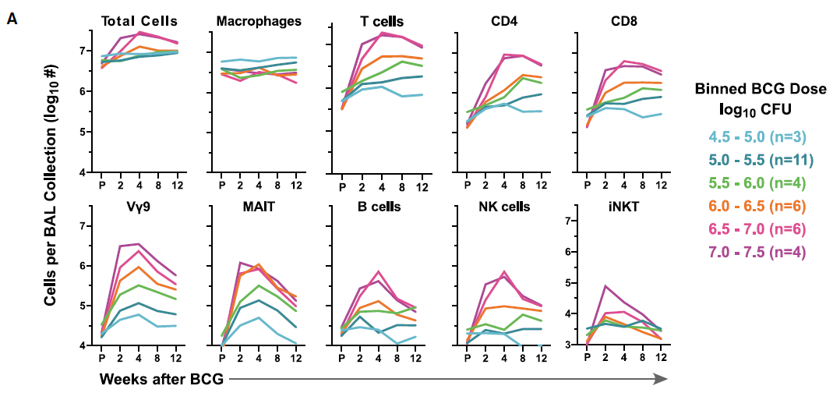
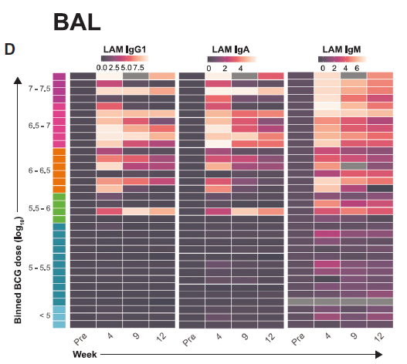
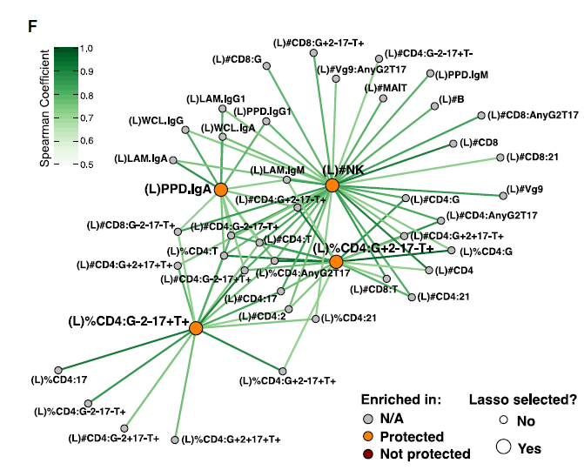
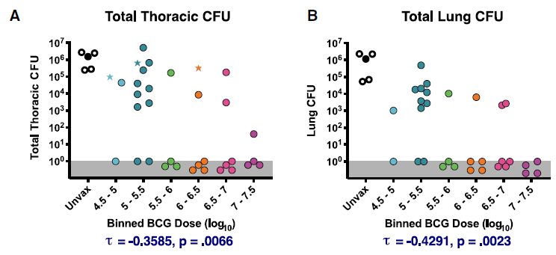
Darrah et al., IV BCG dose study
Dose-ranging study of IV BCG dose in 34 NHP
17 of 34 had no detectable lung CFU after Mtb challenge
IV BCG increased frequency of a broad array of cells in BAL that was dose-dependent
IV BCG also induced LAM-specific IgG1, IgA and IgM
Mtb-specific CD4 Th1/Th17 and NK cells in the airway correlated with protection
No scRNAseq from the dose study; WB bulk RNAseq reported in Liu et al. 2023
Darrah et al., Cell Host and Microbe, 2023
Notes:
Deaths have begun to decline again, but not below pre-pandemic levels

Slide 18
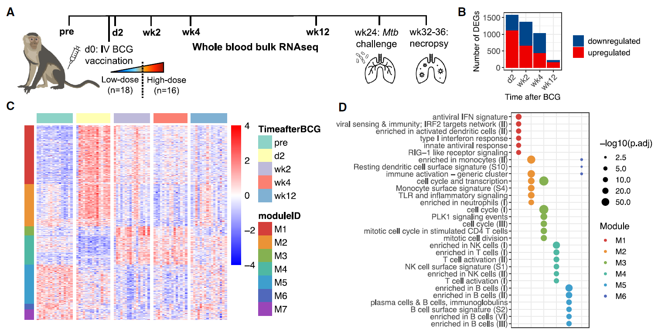
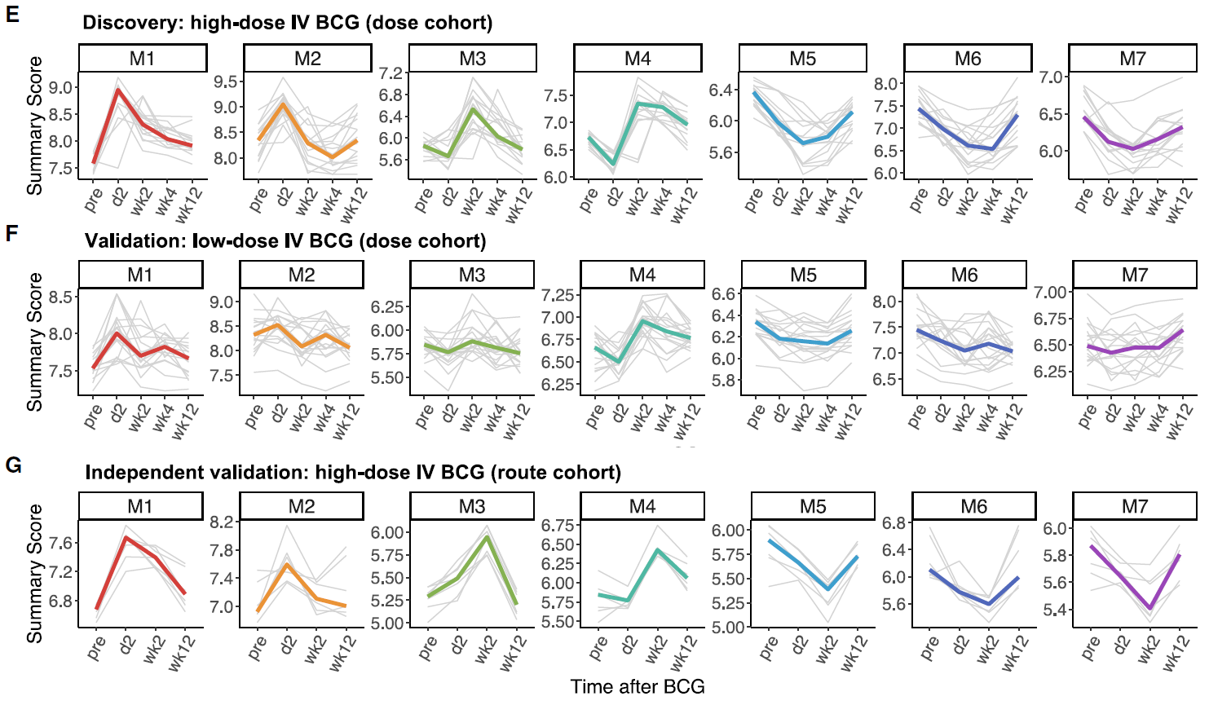
Liu et al., 2023
Whole-blood samples from Darrah et al. “dose study” (n = 34 NHP)
Bulk RNAseq from samples at 2 days, 2 wks, 4 wks, and 12 wks post-IV BCG vaccination
Using discovery cohort identified IV BCG DEGs and formed 7 modules based on correlation
Validated DEGs and modules in validation cohort (low-dose groups)
NOTE: Liu et al. dataset also includes data from the Darrah et al. “route study” for comparison of BAL and blood data from the same animals
Liu et al., Cell Rep Med, 2023
Notes:
Deaths have begun to decline again, but not below pre-pandemic levels

Slide 19
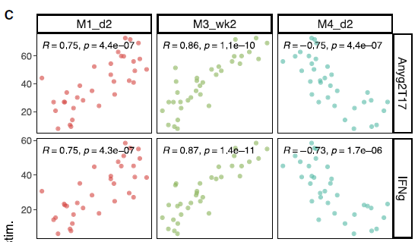
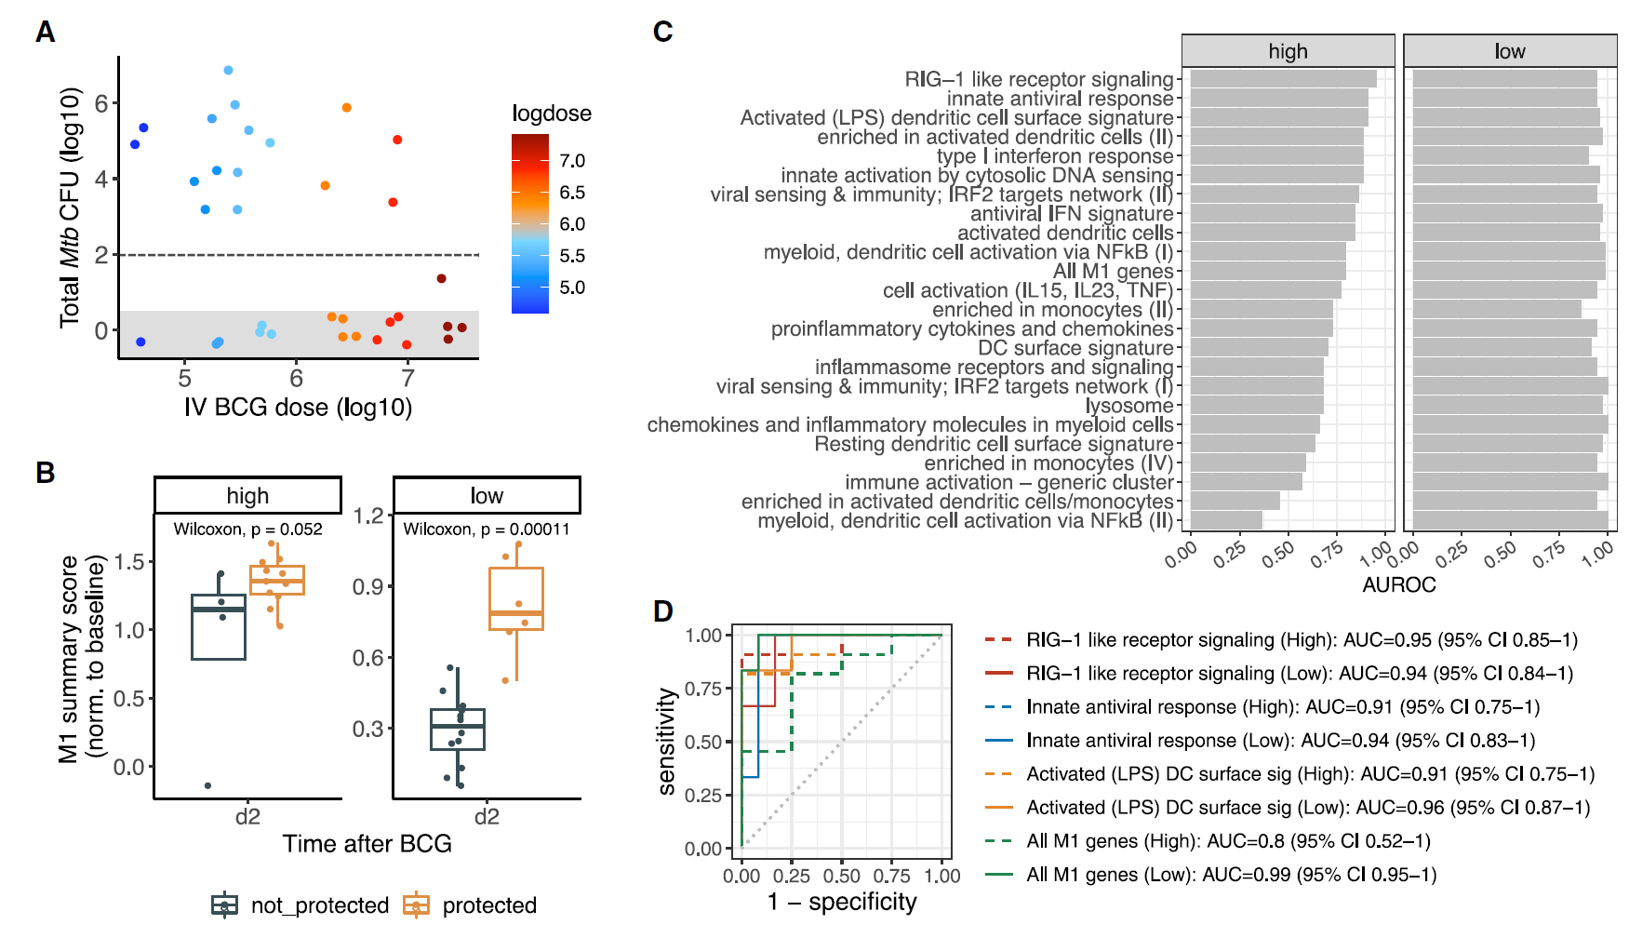
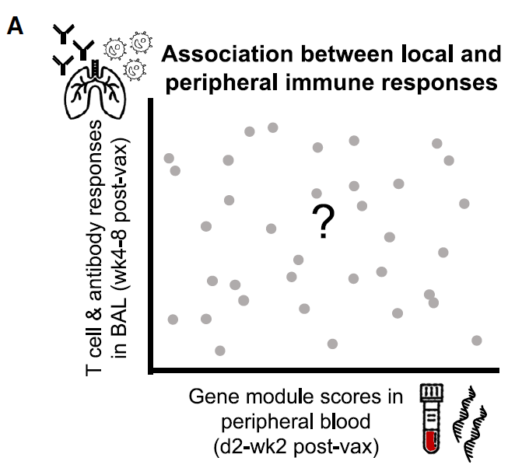
Liu et al., 2023
Assessed correlation between gene module expression and T cell responses in BAL
M1 at d2, M3 at wk2 and M4 at d2 all correlated with WCL-specific CD4+ T cell responses at wk 8
Evaluated module expression with protection
M1 at d2 predicted protection, notably the genes enriched in the RIG-1 receptor signaling pathway, innate antiviral response and activate dendritic cell signature were most predictive
WCL-specific CD4+ T cell response in BAL
Liu et al., Cell Rep Med, 2023
Notes:
Deaths have begun to decline again, but not below pre-pandemic levels

Slide 20
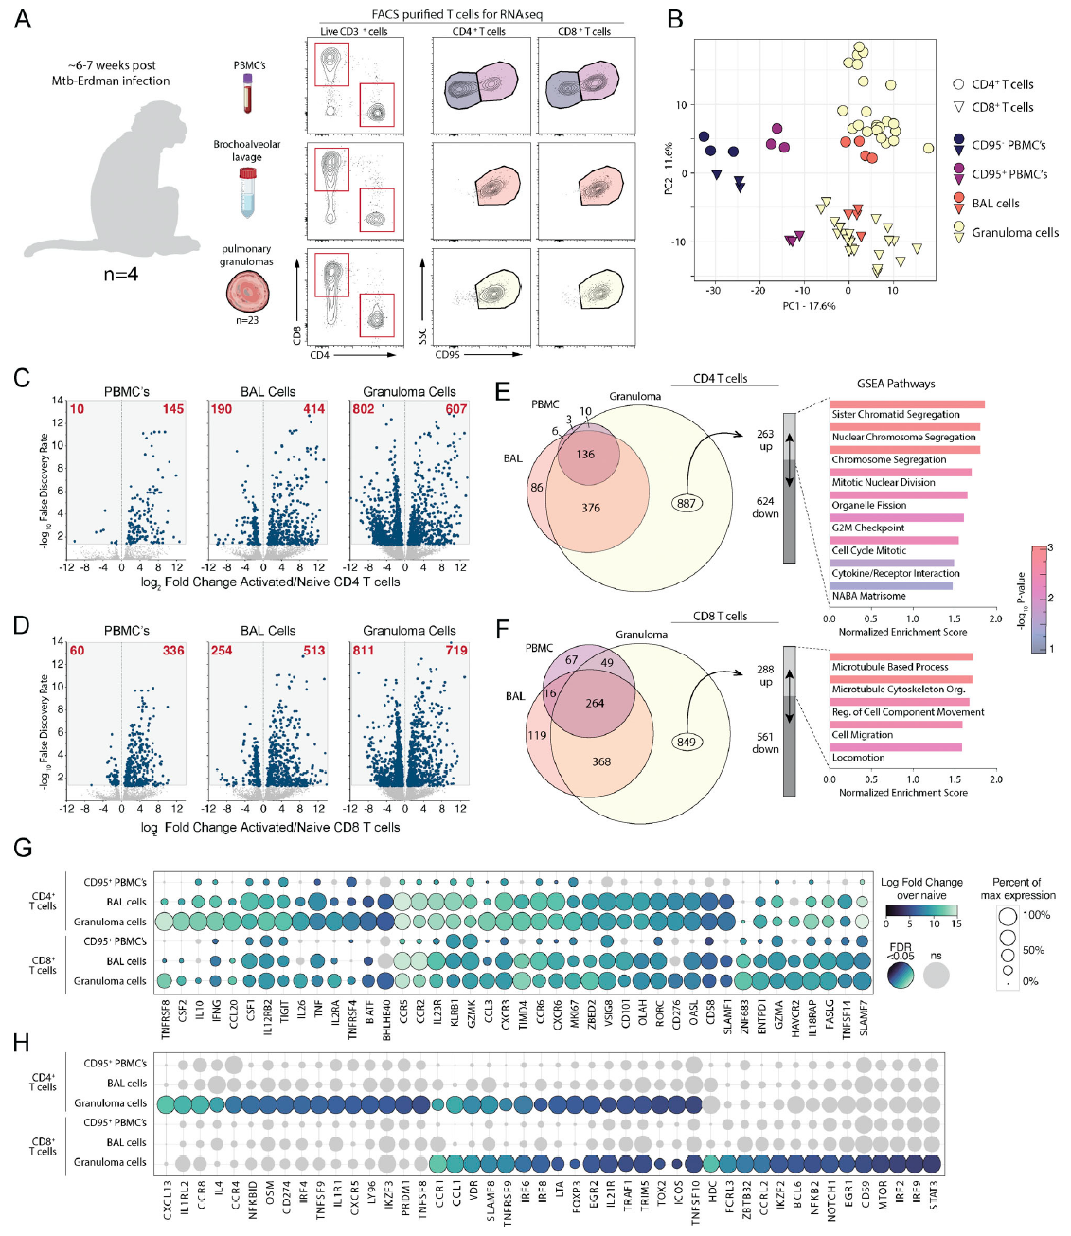
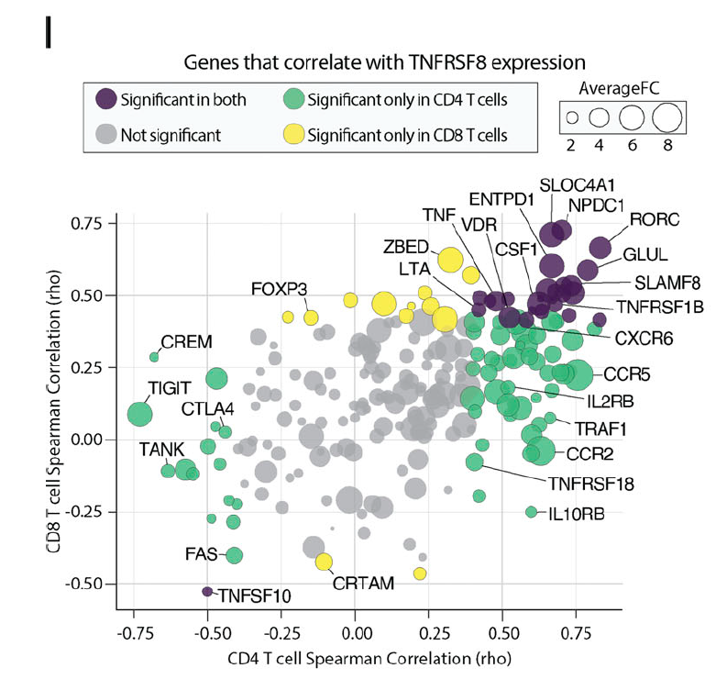
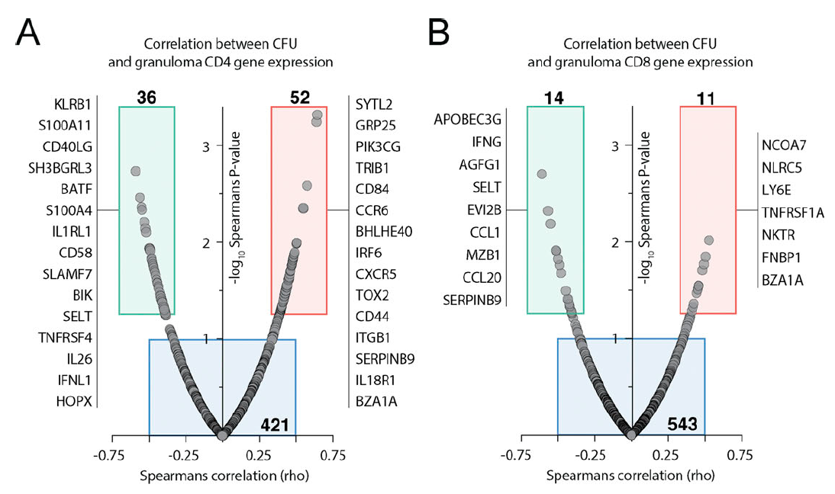
Foreman et al. 2023
Compared T cells from blood, BAL and granulomas 6-7 wks post Mtb challenge (CD95low is a marker of naïve T cells)
Used bulk RNA seq of FACS-purified cells and identified differentially expressed genes across populations
Many genes correlated with granuloma CFU burden, but they differed for CD4 and CD8 T cells
They sought gene markers of granuloma T cells that were shared by CD4 and CD8 T cells and that didn’t correlate with granuloma burden
TNFRSF8 (CD30) was among the top genes upregulated in granuloma CD4/CD8 T cells
CD30-/- mice succumb early to Mtb infection and previously, CD30-ligand (CD153) has been implicated in protection
Foreman et al., J Exp Med, 2023
Notes:
Deaths have begun to decline again, but not below pre-pandemic levels

Slide 21
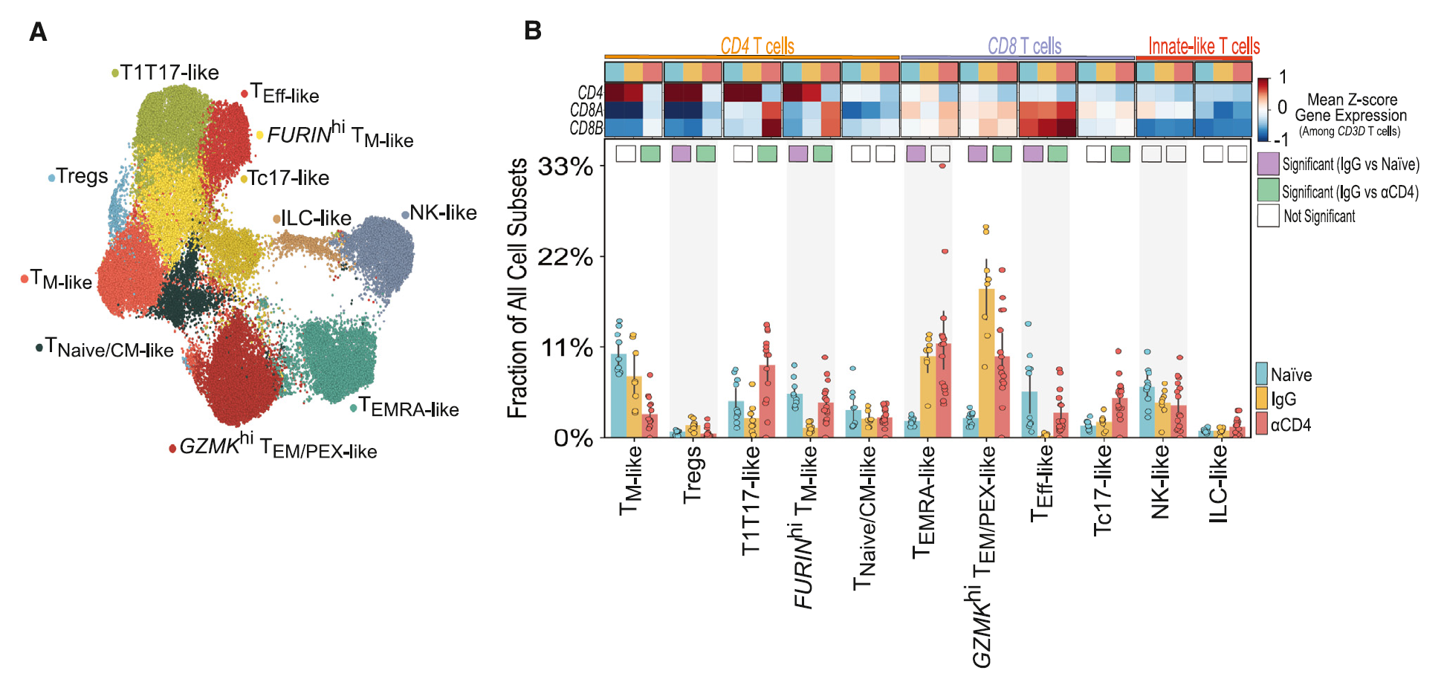
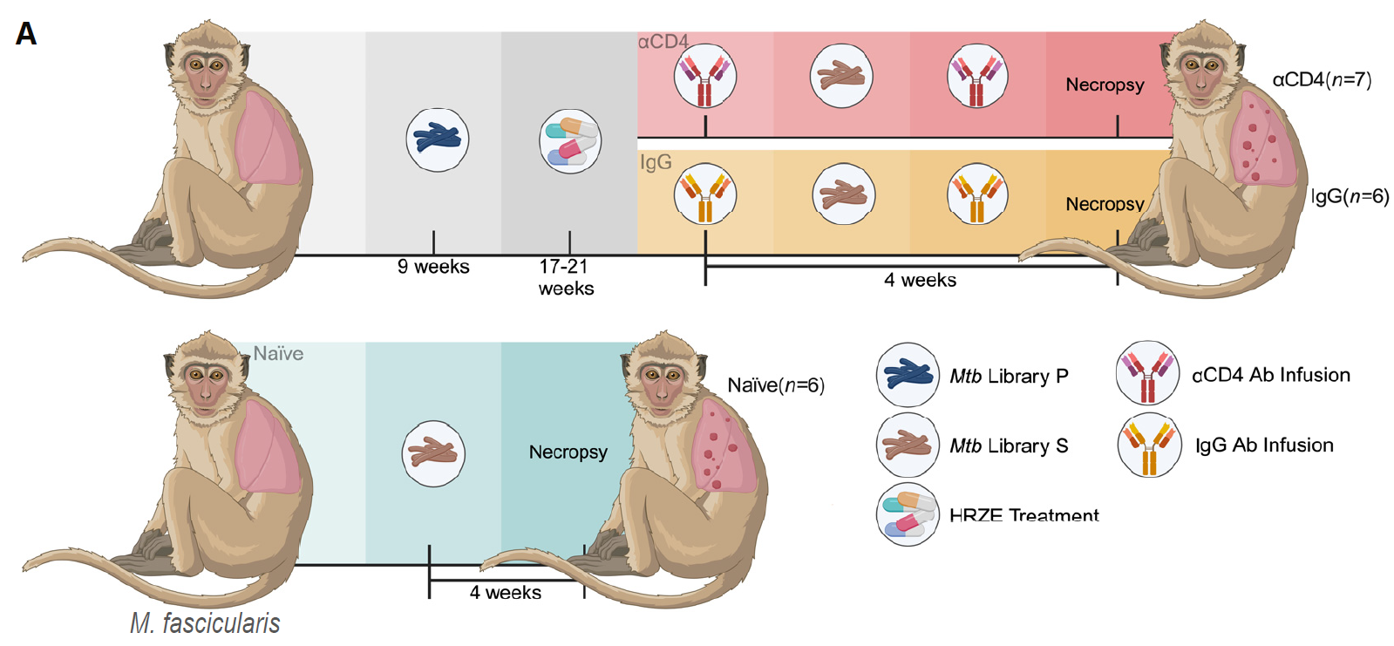
Bromley et al. 2024
Compared cynomolgus macaques in three groups, each challenged by Mtb. after: (1) Primary Mtb. infection + ant-CD4 (CD4+ T cell depletion) (2) Primary Mtb. infection + IgG isotype control (3) No primary Mtb. infection
Presence of CD4+ T cells during reinfection resulted in a less inflammatory lung with reprogrammed CD8+ T cells, reduced neutrophilia, and blunted type 1 IFN among myeloid cells.
CD4+ T cells were required for protection against Mtb in NHP: CD4+ T cells regulate immune tone
Mtb reinfection promoted immuno-modulatory CD8+ T cell biased immunity
Myeloid-derived cells downregulate gene networks implicated in TB susceptibility
Self-reinforcing cellular circuits balance host immunity in reinfection granulomas

Slide 22
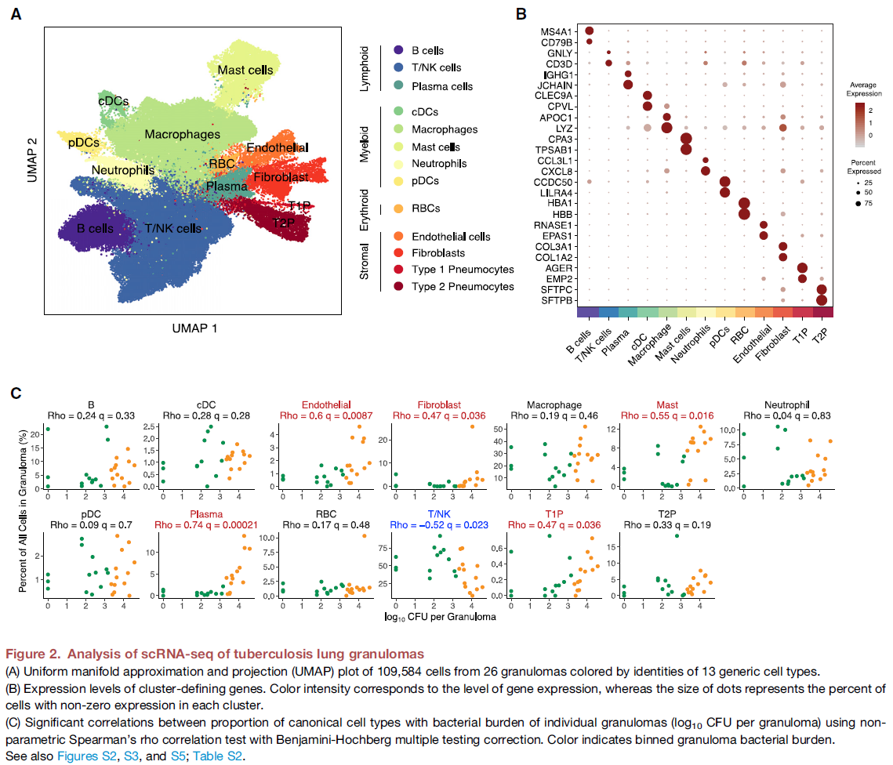
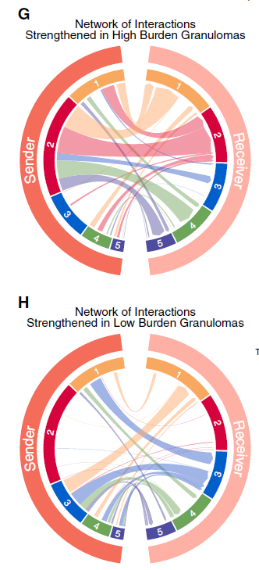
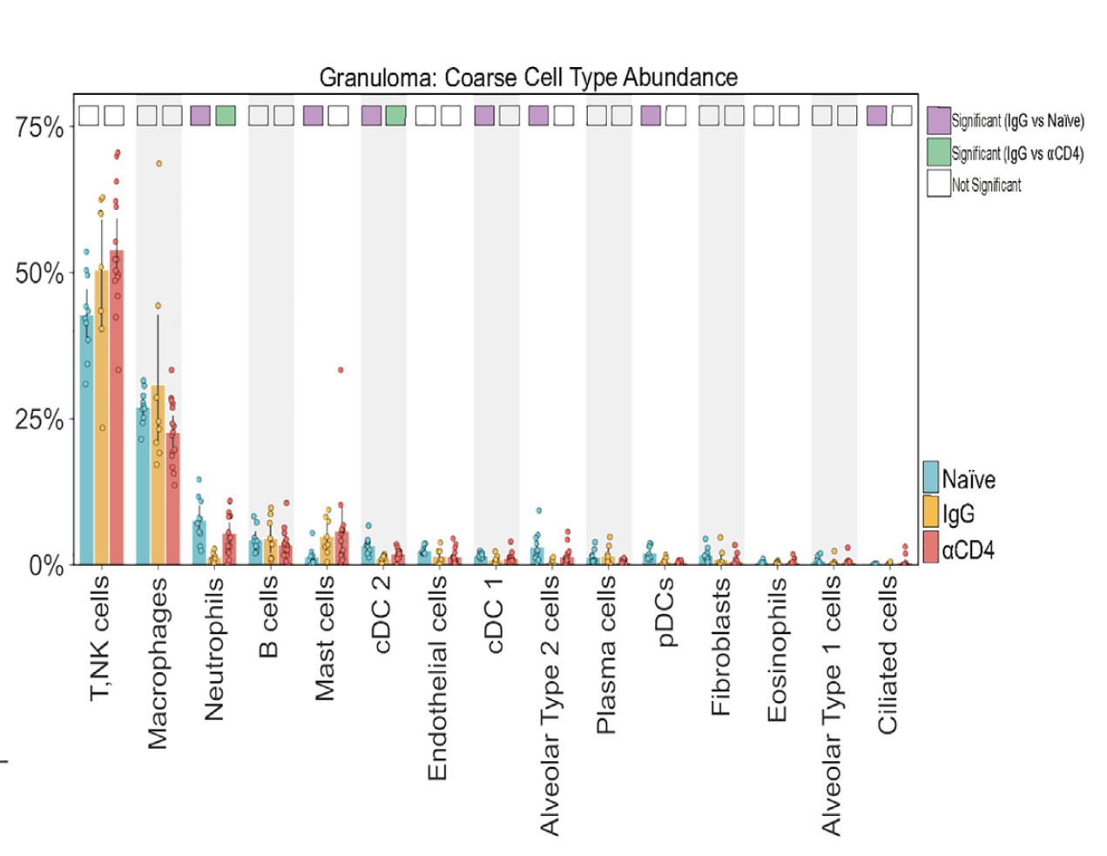
Examples of new directions and cross-study integrations
Baseline gene expression as predictor of BCG response? (Liu et al.)
Identify genes that differentiate granuloma CD4+ T cells and/or associate with low CFU (Foreman et al.) and validate in Bromley et al. granulomas (or vice-versa)
Blood vs. BAL: Does bulk gene expression in blood predict cellular or humoral immune response in BAL? (Darrah et al. and Liu et al. overlap on route study)
Sex or sex-associated genes predictive of BCG response or granuloma gene expression?
TB risk signatures by cell types in blood, BAL and granulomas?
Associations with granuloma burden: non-T cells, using ML with cross-validation or hold-out (Bromley et al, Foreman et al.)
Notes:
Deaths have begun to decline again, but not below pre-pandemic levels

Slide 23
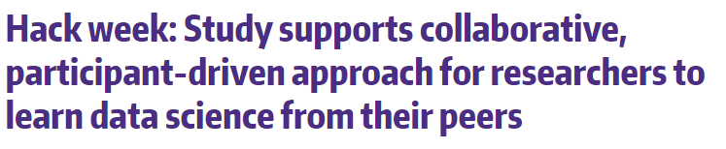

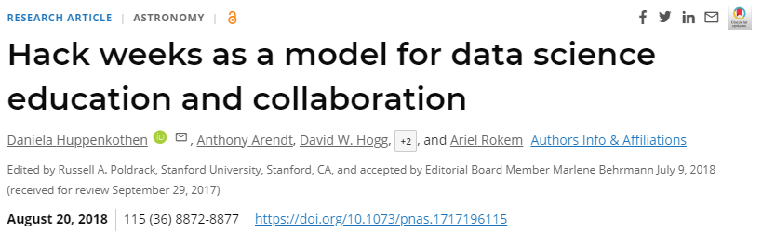

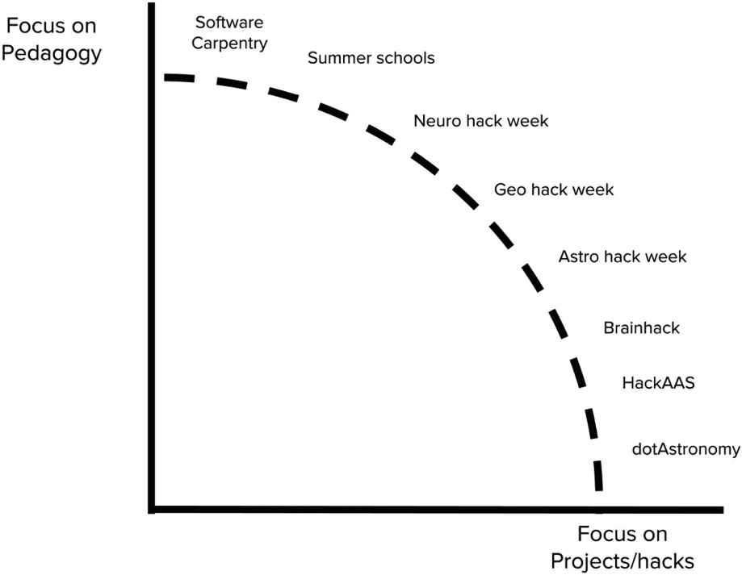





http://astrohackweek.org/2018/
https://www.pnas.org/doi/10.1073/pnas.1717196115
https://oceanhackweek.org/hackweek.html
https://geohackweek.github.io/hackweek.html
https://neurohackademy.org/
Notes:
The hackweek model has emerged within the data science community as a powerful tool for fostering exchange of ideas in research and computation by providing training in modern data analysis workflows. In contrast to conventional academic conferences or workshops, hackweeks are intensive and interactive, facilitated by three core components: tutorials on state-of-the-art methodology, peer-learning, and on-site project work in a collaborative environment. This setup is particularly powerful for sciences that require not only domain-specific knowledge, but also effective computational workflows to foster rapid exchange of ideas and make discovery, as has been shown by the success of the previous Astro- and Neurohackweeks. This is an excellent match with the nature of geospatial research where data are large and complex and the community is diverse and collaborative.

Slide 24
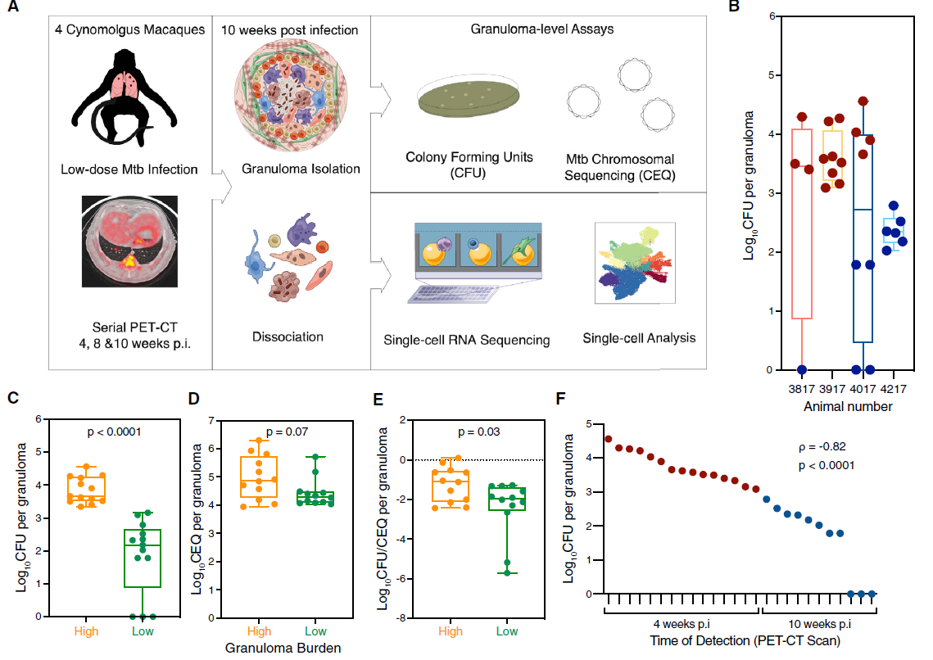
Gideon et al. 2022
Study established the largest granuloma cell atlas with 6 NHP, 32 granulomas and 120K single cells
Showed range of Mtb burden among granulomas even within one animal
Clustered cells from 10 wk granulomas (4 NHP, 26 granulomas, 10 wks post-challenge)
Divided granulomas into low and high burden
Gideon et al., Immunity, 2022

Slide 25
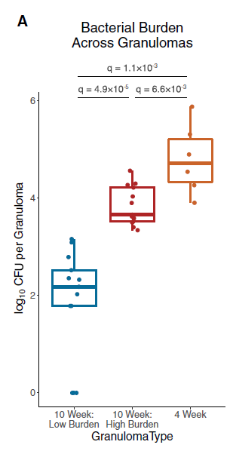
Gideon et al. 2022
4 wk granulomas had higher CFUs than 10 wk high and low burden granulomas
Mast cells and type II immunity underlie early, high-burden granulomas
Th1 and Th17 cells associated with late-forming, low-burden granulomas
Network interaction analysis also suggested group 2 cells (i.e., mast, fibroblast, endothelial, plasma, type 1 pneumocyte, and Mac4) had increased interaction in high-burden granulomas
High
burden
Low
burden
Gideon et al., Immunity, 2022

